Slide 1
Data Analysis of Product Sale US cities
By,
Shamini Puthooppallil
Trainee Data Scientist- Data Disca
LinkedIn

Slide 2
OBJECTIVES
Main objectives of this data analysis are:
Determine the factors affecting the price of product in US main cities from careful descriptive and exploratory analysis.
Visualize the results and present the outcome in a meaningful manner

Slide 3
DATA PREPARATION…
Understanding the variables:
date_w - Date of purchase
Price - Price of the product
total_vol - Total volume purchased
Plu1,plu2, plu3 - Price look-up codes (a system of numbers that uniquely identify bulk produce sold in grocery stores and supermarkets)
bags_t ,bags_s,bags_l ,bags_lx - Bag size
Type - Type of product
Year - Year purchased
Location - Purchase location

Slide 4
DATA PREPARATION
Data Wrangling:
Removed some rows which are not relevant and corrected the year columns
Some of the locations like ‘South Central’,’Total US’,’West’,’Total US’ etc. represent a group of locations so, those locations are avoided from the location analysis.
Year field was represnting the previous year. Corrected the ‘year’ field by substituting the year from date variable.

Slide 5
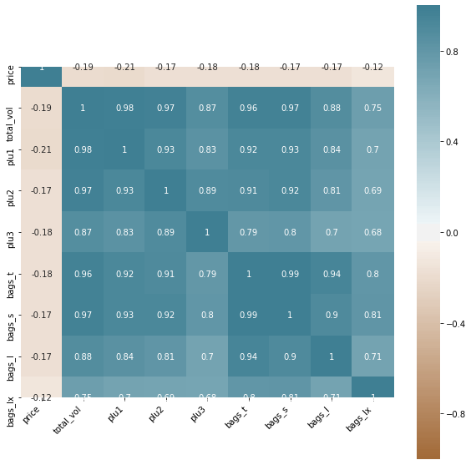
DATA EXPLORATION
Correlation Chart
All the numeric values are negatively correlated with price of the product
Highly correlated values:
Bags_t &Bags_s
Total volume & PLU 1
Total volume & PLU 2
Total volume& Bags_s
Total volume & Bags_s
Conclusion: Most of the features have a positive impact on Total volume of the product.

Slide 6
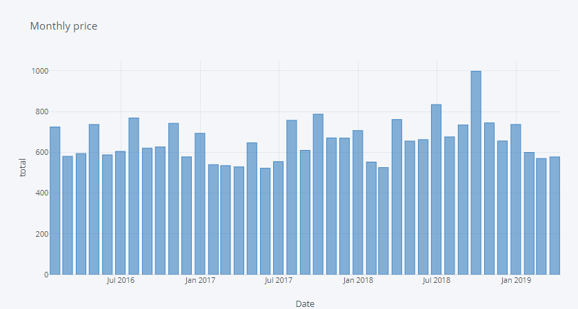
DATA EXPLORATION…
Monthly price distribution of the product
There is a price hike in almost once in two months
Highest value of sales noticed in September 2018
SEP 2018

Slide 7
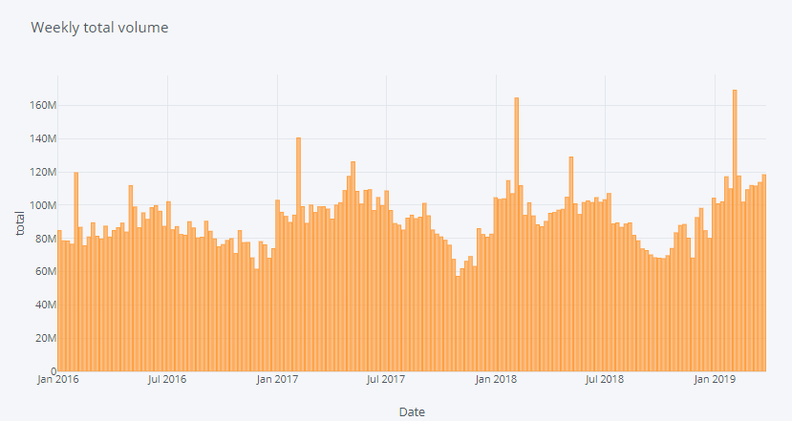
DATA EXPLORATION…
Weekly Total Volume distribution of the product
There is an exceptional peak of in the total volume in the product in first week of February
Volume is really low in November in every year
Feb 4 2018
Feb 3 2019
SEP 2018
Feb 5 2017
Feb 1 2016

Slide 8
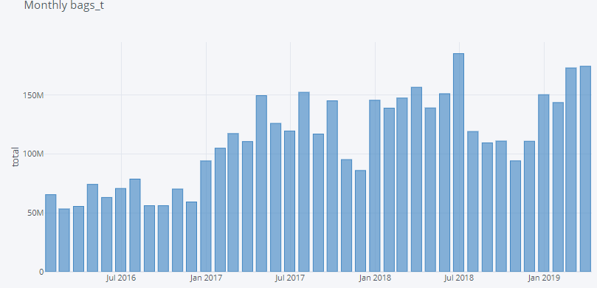
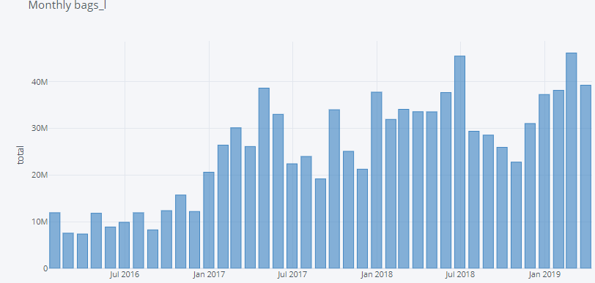
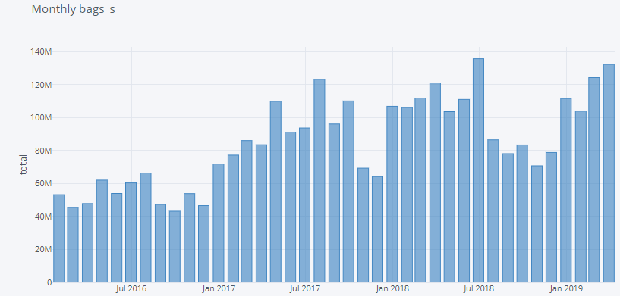
DATA EXPLORATION…
Monthly Bag distributions of the product
Bag s ,Bag t and Bag L shows a steady increasing trend starting from Jan 2016 to March 2019

Slide 9
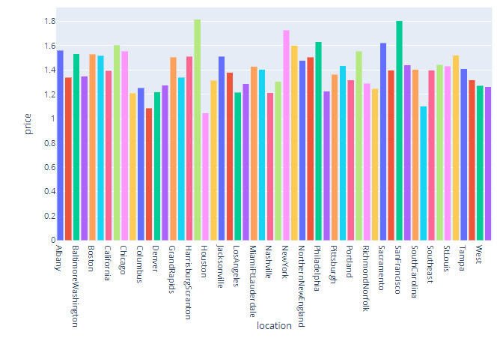
DATA ANALYSIS
Price distribution of the product by Location
HeartFoldSpringField, New York and San-Fransciso are the locations which shows highest sales amount in every year

Slide 10
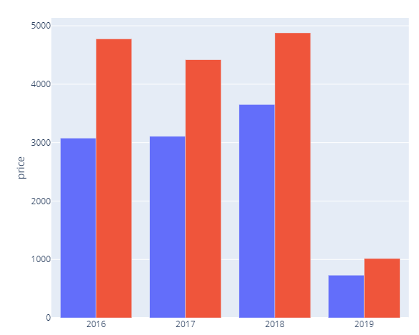
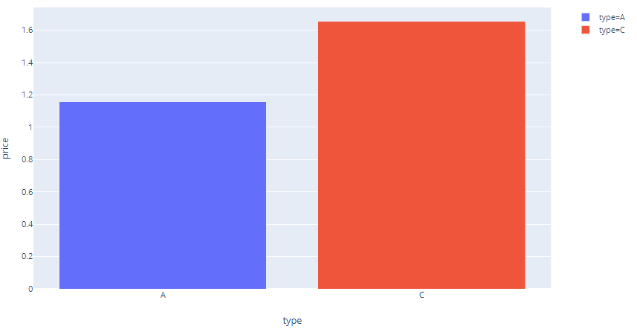
DATA ANALYSIS …
Price distribution of the product by Type
Type C shows highest price amount as compared to type A
2018 shows the largest price among the 4 years

Slide 11
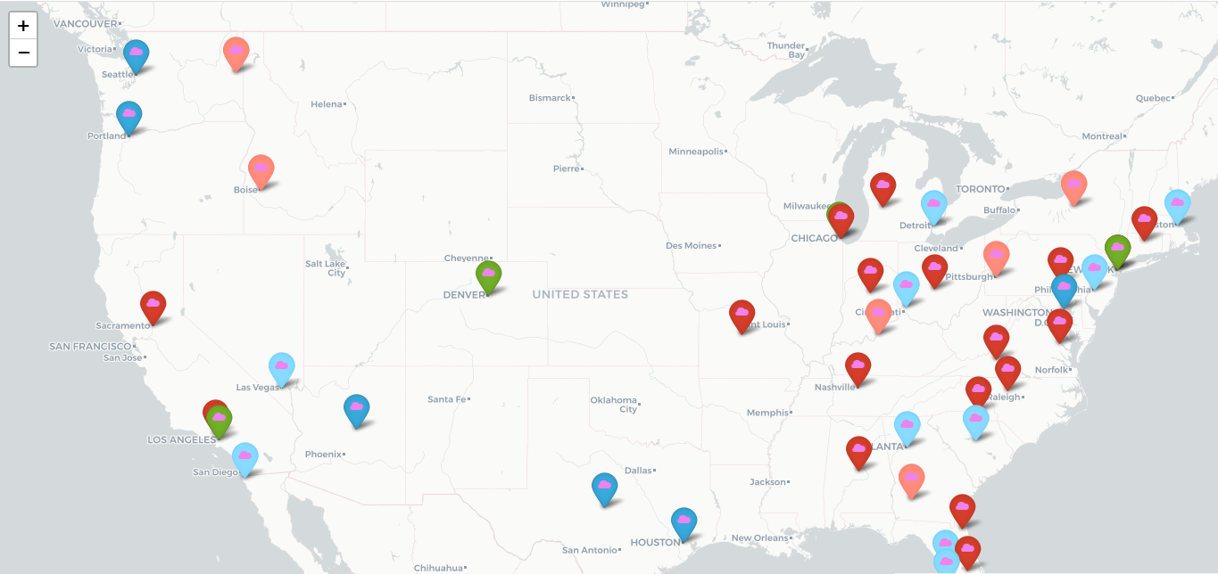
RESULTS
Geographical Distribution of Bag_t –USA
Available at:

Slide 12





RESULTS…
Color indicator:
Lowest Bag_t
Highest Bag_t
There are less than 10 locations having total values of bag-t <100000
Most of the values are below in the range of 25000 -50000
Cities which has highest values of bag_t are located in the west part of USA
There is a strong correlation between total volume of product and bag size

Slide 13
Thank You

